Slide 1
Are Cigarettes on the Decline?
DS102 Final Project

Slide 2
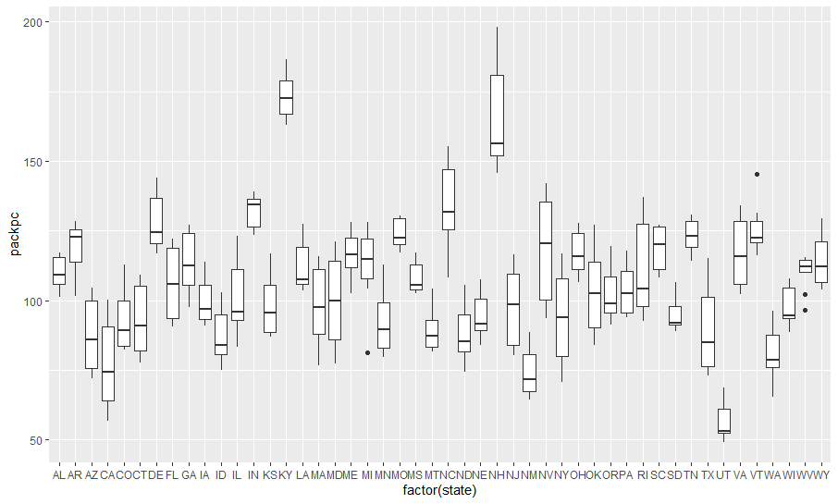
Number of Cigarette Packs per Capita by State
Which states have the highest number of packs?
Kentucky, New Hampshire and North Carolina have the highest.
Which have the lowest?
Utah, New Mexico and California have the lowest.
ggplot(Cigarette, aes(x = factor(state), y = packpc)) + geom_boxplot()
Cigarette %>% group_by(state) %>% summarise(Mean = mean(packpc)) %>% arrange((Mean))
Cigarette %>% group_by(state) %>% summarise(Mean = mean(packpc)) %>% arrange(desc(Mean))

Slide 3
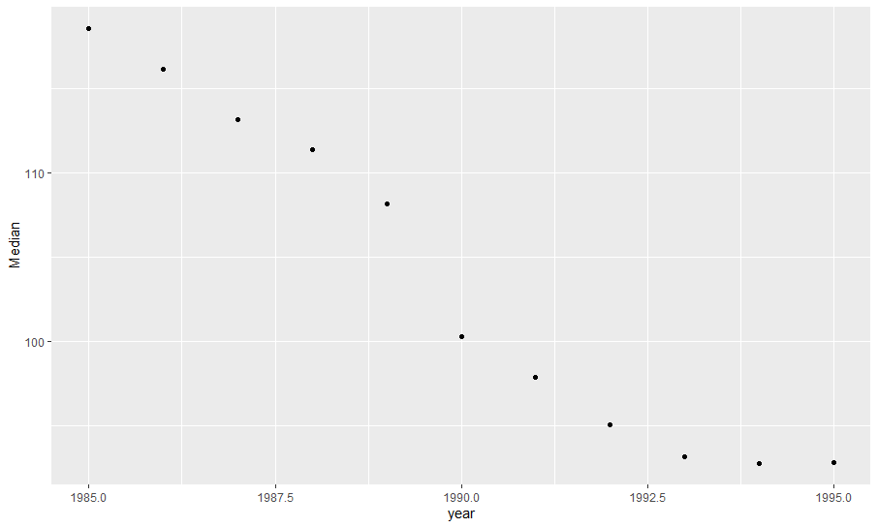
Trending Down
What can you say about cigarette usage from 1985 to 1995?
There is clearly a significant decline in cigarette usage from 1985 to 1995, most likely due to more awareness of the dangers of smoking and the repercussions that follow.
MedianCig <- Cigarette %>% group_by(year) %>% summarise(Median = median(packpc))
unique(Cigarette$year)
ggplot(MedianCig, aes(x=year, y=Median)) + geom_point()

Slide 4
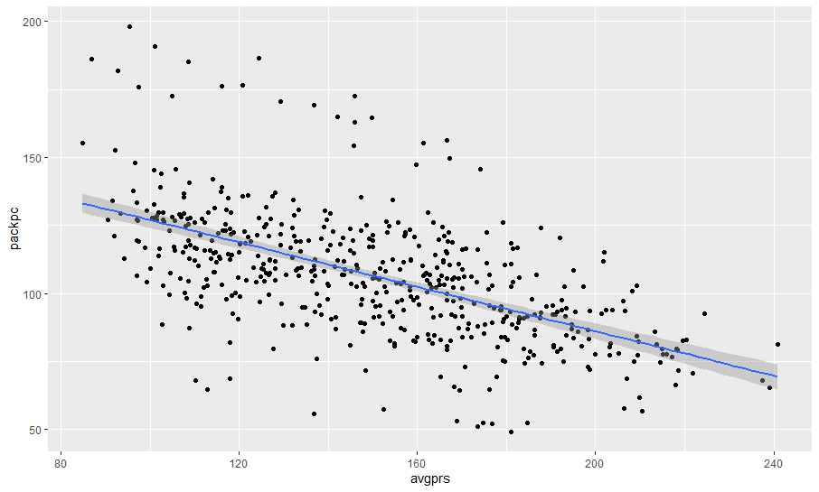
Correlation
Are the price and the per capita packs positively correlated, negatively correlated, or uncorrelated?
The price and the per capita packs are negatively correlated, as shown in the scatterplot here. This confirms my assumptions that the use of cigarettes is declining.
ggplot(Cigarette, aes(x=avgprs, y=packpc)) + geom_point() + geom_smooth(method=lm)

Slide 5
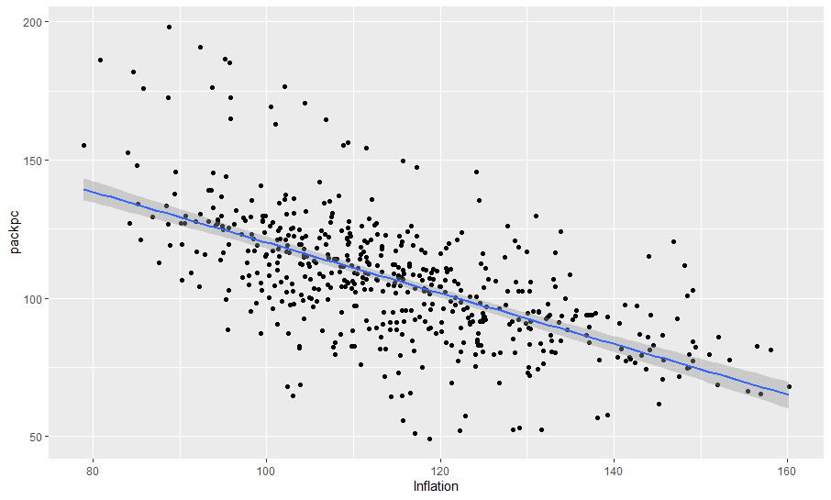
Adjusted Inflation
This scatterplot shows a more concentrated negative correlation with the adjusted inflation from 1985 to 1995.
How much variability does the line explain?
38% of the variability!
Infl <- Cigarette %>% mutate(Inflation = avgprs / cpi)
ggplot(Infl, aes(x=Inflation, y= packpc)) + geom_point() +geom_smooth(method=lm)
regression <- lm(packpc~Inflation, Infl)
summary(regression)

Slide 6
Overall Significant Difference?
Using a paired t-test:
t = 14.789, df = 47, p-value < 2.2e-16
alternative hypothesis: true difference in means is not equal to 0
In other words, there IS a significant difference in the number of packs per capita. This confirms that there are less number of packs per capita in 1995 compared to 1985.
Cigs1985 <- Cigarette %>% filter(year == 1985)
Cigs1995 <- Cigarette %>% filter(year == 1995)
t.test(Cigs1985$packpc, Cigs1995$packpc, paired = TRUE)

